Slide 1







IBM Data Analyst Capstone Project
Michael Le
16/01/2023

Slide 2



OUTLINE
Executive Summary
Introduction
Methodology
Results
Visualization – Charts
Dashboard
Discussion
Findings & Implications
Conclusion
Appendix

Slide 3
EXECUTIVE SUMMARY
The most popular languages are mostly web-developed tools such as JavaScript, HTML
Among all the Web-frames, most used are jQuery and React.js
Platforms frequently used are Windows and Linux.
Best Dataframes often used mySQL and PostreSQL are better uses for performing database management systems.

Slide 4

INTRODUCTION
As were in the 21st Century, the technology market changes rapidly each year.
It is essential to understand certain technologies integrated in the distant future.
With further insight comparing current and next year trends in technology which is safe to use.
This consists 4 examples of usage such as:
Programming Languages
Databases
Platforms
Web-frame

Slide 5

METHODOLOGY
The technology trend is studied by comparing current and future technology usages
The dataset came from “Stack Overflow Developer Survey 2019”.
There will be different types of data visualizations such as bar, line, pie, tree-map to help us understand results.
The IBM dashboard allows us to analyze data and create visualizations.

Slide 6
RESULTS
There are 4 Main Dashboards to further Understand Current and Future Technologies and Demographics trends.
Programming Languages
Databases
Platforms
Webframes

Slide 7
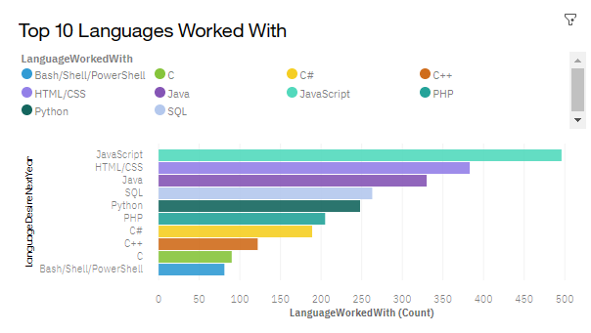
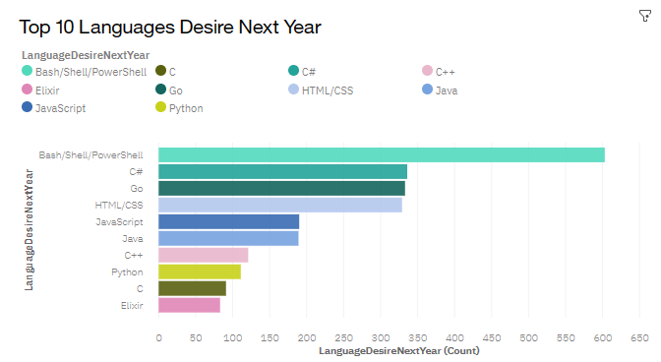
Comparison of Desired Programming Languages
Current Year
Next Year

Slide 8
PROGRAMMING LANGUAGE TRENDS
Current Year
Next Year
Web Programming languages still stay dominant soon.
Python and Data Science are essential in the future as AI and Technologies improve.
Oldest programming languages such as C++, PHP,…. are becoming less frequent.
JavaScript & HTML/CSS are common languages for both present and future trends.
Python moves from 5th to 3rd within the top 10.
Some languages like C++ and PHP area disappears from the top 10.

Slide 9
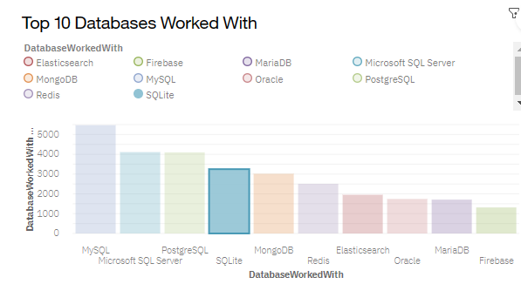
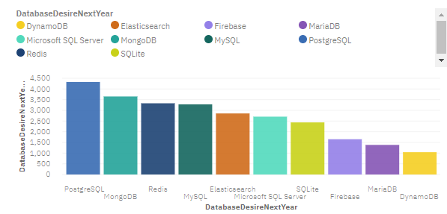
DATABASE TRENDS
Current Year
Next Year

Slide 10
DATABASE TRENDS - FINDINGS & IMPLICATIONS
Findings
MongoDB & Redis changed position from No. 2 and No. 3
PostgreSQL moves from No.3 to No.1
MS SQL server drops from No.2 to No. 5
Oracle disappear from the top.
Implications
Open-source database becomes usable compared to the commercial one.
More non-relational databases increases in the future. As opposed to relational databases still takes leading position in the future.

Slide 11
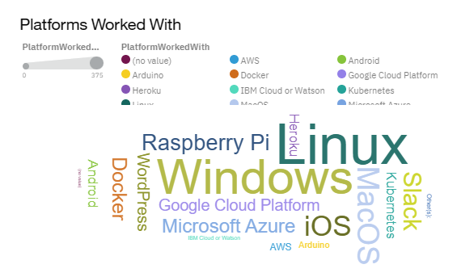
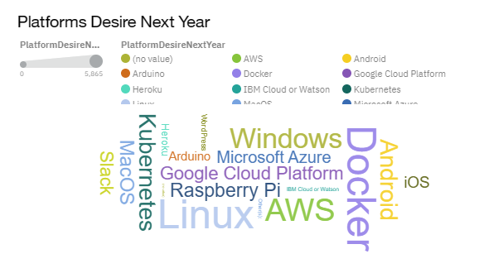
PLATFORM TRENDS
Current Year
Next Year

Slide 12
PLATFORM TRENDS - FINDINGS & IMPLICATIONS
Findings
Windows and Linux remains the most popular platforms.
Andriod ranks No 1. in the mobile platform.
Cloud platform such as Kubernetes, Docker, AWS has larger market shares.
Implications
Windows and Linux remain are usable in the future.
The transformation of cloud computing becomes ubiquitous, can be used quite often.

Slide 13
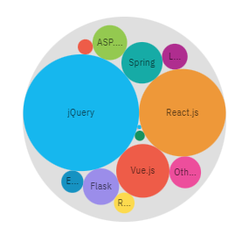
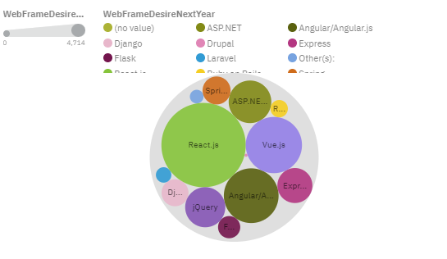
WEB-FRAME TRENDS
Current Year
Next Year

Slide 14
WEB-FRAME TRENDS - FINDINGS & IMPLICATIONS
Findings
jQuery changes position from No. 1 to No. 4
React.js changes from No. 3 to No. 1
Vue.js increases rapidly from No. 9 to No. 3.
Angular.js remains the same.
Implications
jQuery loses market share shows less interest in future development.
React.js and Vue.js becomes the new standard for web frame development.

Slide 15

DASHBOARD
<https://dataplatform.cloud.ibm.com/dashboards/8b9246ef-f625-4c0d-bbb6-acda4c0fcfa4/view/4c39f921049e0cc85cc9b1e407912e502b662759e3bb8351d68d7b495d347097f3681a96c87b1f5adc450162a7e5175fce>

Slide 16
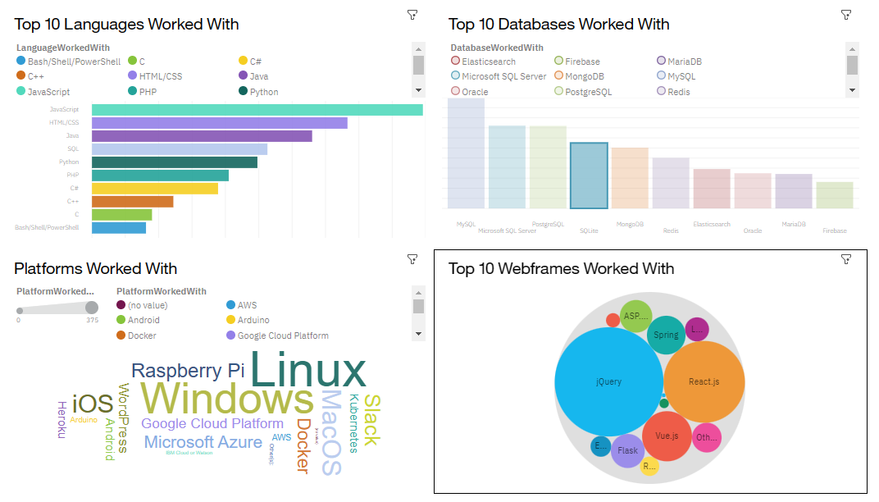
DASHBOARD TAB 1

Slide 17
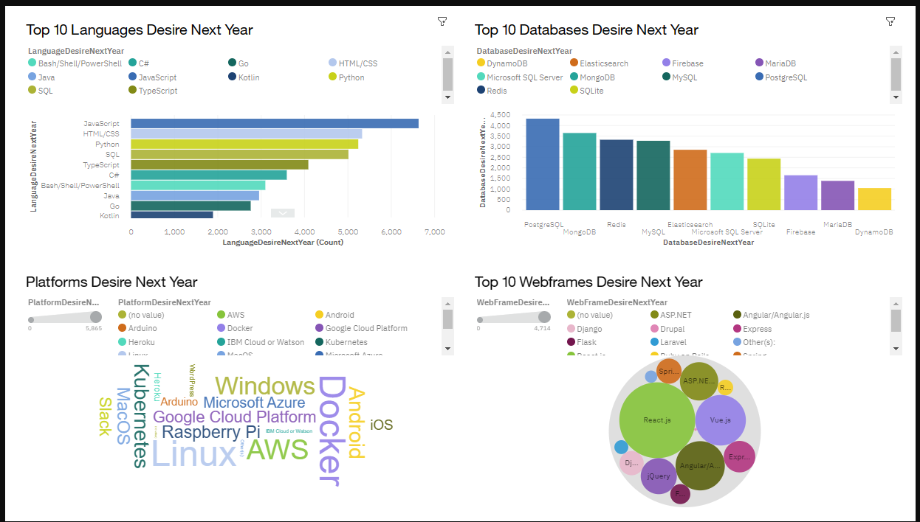
DASHBOARD TAB 2

Slide 18
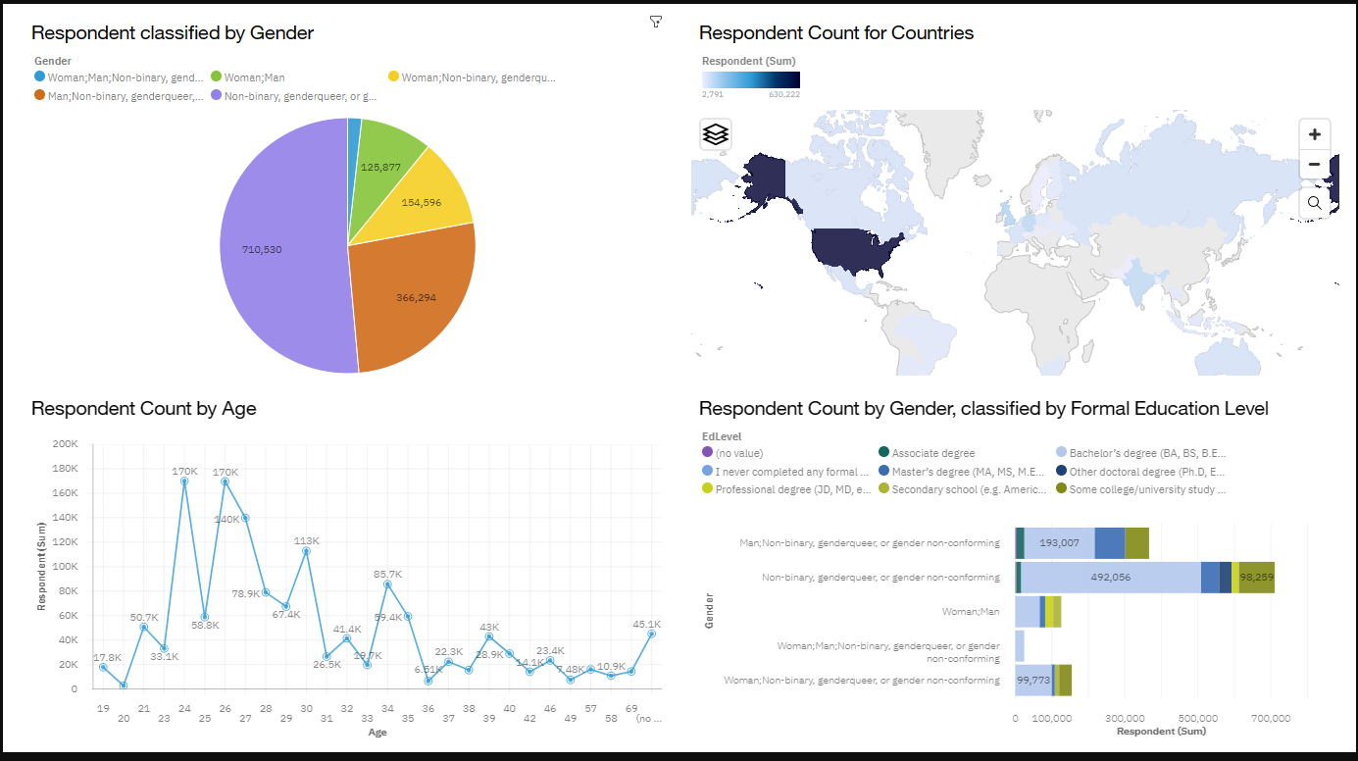
DASHBOARD TAB 3

Slide 19
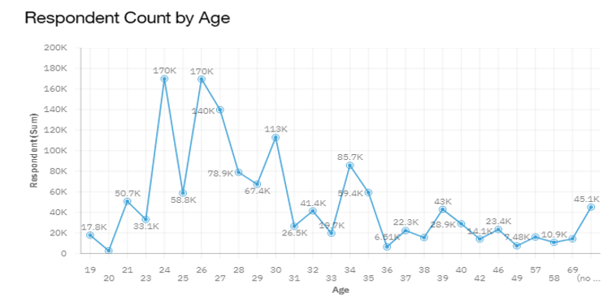
DISCUSSION
Majority of respondents ages around 23-27.
Shows a positive skewness in favour of new technology.

Slide 20
OVERALL FINDINGS & IMPLICATIONS
Findings
Non-relational database moves position to No. 2 & No 3.
Web-frame programs stays at No 1.
React.js stays at No.1 on web framework.
Implications
Web-based applications will dominate modern applications.
Non-relational databases increases adaptability over time.
Cloud-based services become top-priority for platform development.

Slide 21

CONCLUSION
To stay updated in the technology field, it is essential to understand web-based languages and non-relational databases.
Among web framework, React.js is highly recommended.
Cloud-based services is the better option for people whose interests in studying or investing in IT.

Slide 22

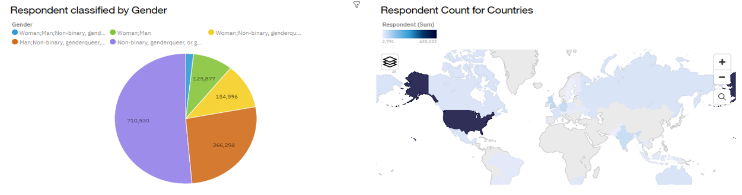
APPENDIX

Slide 23
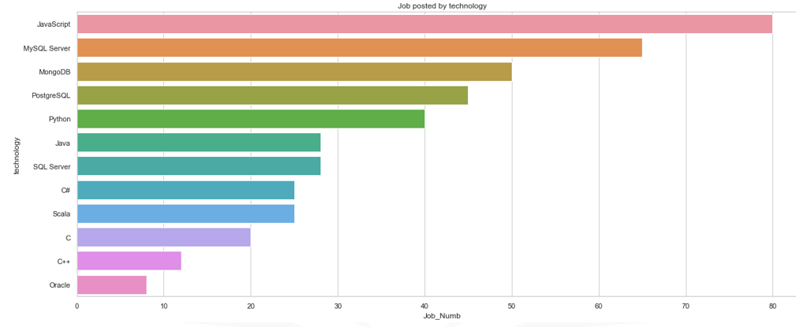
JOB POSTINGS

Slide 24
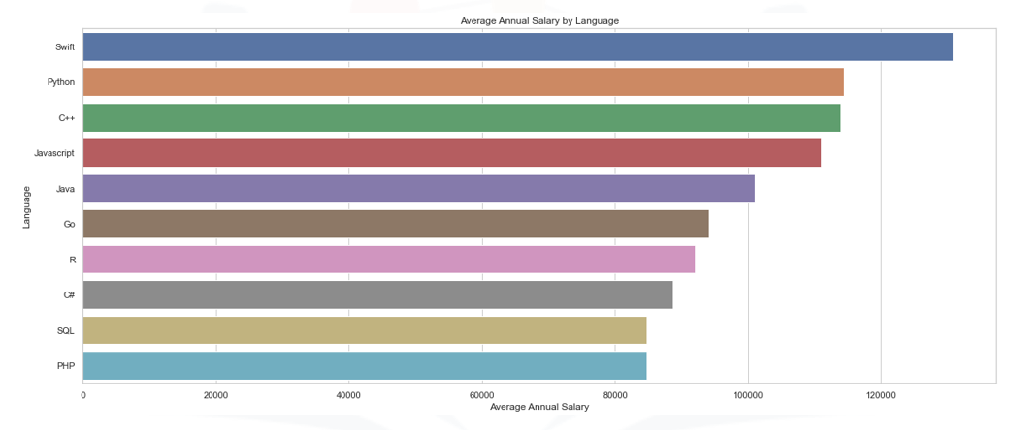
POPULAR LANGUAGES

